Slide 1
MetLife TakeAlong DentalSM The last dental program they will ever need
Notes:
This presentation is designed primarily for existing customers.

Slide 2
A plan that offers savings, choice and anywhere, anytime service
Negotiated fees generally 15% to 45% below average charges in a dentist’s community*
Access to thousands of participating dental locations across the U.S. 374,000 in network locations.
Plus access to international dentists in more than 200 countries through
MetLife's International Dental Travel Assistance Program**
Flexibility to go to any dentist — in or out of the network. Check www.metlife.com and click “find a dentist”, choose PDP Plus network.
Access to pre-treatment estimates, coverage verification, claim status and more, via Internet, fax or Customer Service Representatives
*Savings from enrolling in a dental benefits plan will depend on various factors, including the cost of the plan, how often participants visit the dentist and the cost of services rendered. Negotiated fees for non-covered services may not apply in all states.
**International Dental Travel Assistance services are administered by AXA Assistance USA, Inc. AXA Assistance is not affiliated with MetLife, and the services they provide are separate and apart form the benefits provided by MetLife.

Slide 3
Valuable dental benefits for retirement
Individuals value dental benefits throughout their life stages – including retirement.
An effective retiree dental plan should:
Control plan risk
Offer a choice of plan designs
Be simple and easy to understand
Make it easy for employers to maintain
Help retirees make informed choices
Notes:
Individuals value dental benefits throughout their life stages – including retirement.
We believe an effective retiree dental plan should:
Control plan risk to drive long-term rate stability
Offer a choice of plan designs to meet retirees’ personal and financial needs
Be simple and easy to understand
Make it easy for employers to maintain it
Offer clear decision support tools that encourage retirees to take action
Provide a comprehensive educational platform to help consumers make informed choices about their dental benefits and oral health

Slide 4
Proven expertise makes the difference
Proven Expertise
More than 50 years of experience in the dental business
Dental benefit administration for more than 21 million people¹
Extensive experience with employee-paid benefits
Broad voluntary benefits portfolio
Brand recognition
¹ Based on enrolled lives. MetLife data as of January 2016.

Slide 5
New solutions that balance cost with your needs
The last dental program they you ever need
Robust coverage you will value
Choice of programs to meet individual needs
Flexible waiting periods so individuals get access to coverage quickly
Portable solution for continuation of coverage
Health and wellness (oral health library)*
*Not available in all states
Notes:
Unlike many individual dental offerings that only feature a percentage discount card or provide very limited coverage and networks, MetLife TakeAlong Dental provides robust coverage.
Employee choose from standard program designs to meet their individual needs
3 DPPO options
2 DHMO options, where available
The standard programs, like MetLife’s group plans, are based on research, treatment protocols and market trends — helping to provide the coverage employees want.
Flexible waiting periods so individuals get access to coverage quickly
PPO: Ability to waive the waiting period with proof of in force coverage (one year or more); For Basic (Class B), Major (Class C), and Orthodontia (where offered)
DHMO: No waiting period.
MetLife TakeAlong is a great solution for those not eligible for dental coverage under your group plan as well as those looking for an alternative to COBRA.
It can also be a solution for dependents who are aging out of their dental plans [at age 26].
MetLife TakeAlong Dental is not COBRA coverage and does not affect any employer obligation to provide COBRA coverage.

Slide 6
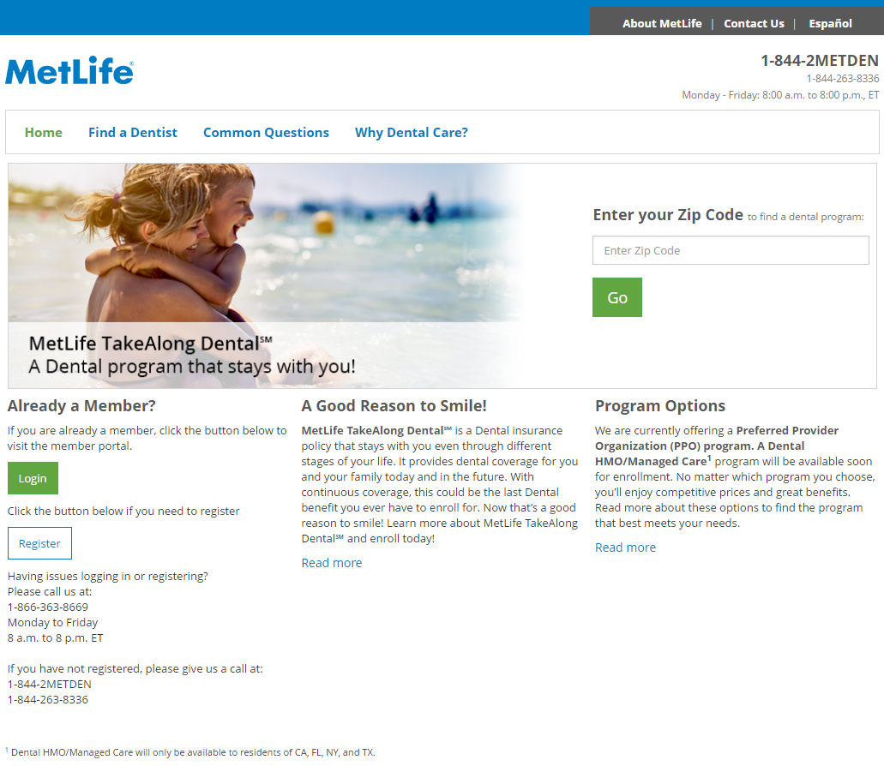
Easy to get started
metlifetakealongdental.com – RCSD Referral Code: RCSDRetireeDental
Notes:
The MetLife TakeAlong Dental website is easy to use and provides all the information employees need to enroll. They simply enter their home zip code to review the programs available in their state.

Slide 7
Make informed decisions
Review the options
 | High Option Benefit Based on the maximum allowed charge¹ | Medium Option Benefit Based on the maximum allowed charge¹ | Low Option Benefit Based on the maximum allowed charge¹
Preventive & Diagnostic Services | In-network: 100% Out-of-network: 100% | In-network: 100% Out-of-network: 100% | In-network: 100% Out-of-network: 100%
Basic Restorative Services | In-network: 80% Out-of-network: 80% | In-network: 70% Out-of-network: 70% | In-network: 70% Out-of-network: 70%
Major Restorative Services | In-network: 50% Out-of-network: 50% | In-network: 50% Out-of-network: 50% | In-network: 50% Out-of-network: 50%
Child Orthodontia Covered Services² | In-network: 50% Out-of-network: 50% | Orthodontia not covered | Orthodontia not covered
Calendar Year Deductible -Applies to Basic & Major Restorative Services Individual Family | $25 $75 | $50 $150 | $75 $225
Waiting Period³ | 6 months for Basic Restorative 12 months for Major Restorative & Child Orthodontia | 6 months for Basic Restorative 12 months for Major Restorative
Calendar Year Maximum Benefit | $2,000 / person | $1,500 / person | $1,000 / person
Child Orthodontia Lifetime Maximum | $1,000 / person | Orthodontia not covered | Orthodontia not covered
Dependent Age | A dependent child is eligible for benefits up to his/her 26th birthday.²
Notes:
Individuals can easily compare the program options available to them, coverage and cost.

Slide 8
Make informed decisions
Review the options
PREVENTIVE | Frequency
Prophylaxis (cleanings) | Two per calendar year
Oral examinations | Two per calendar year
Topical fluoride treatment | One per calendar year for dependent children up to his/her 14th birthday
Bitewing x-rays | One set every calendar year One set every 6 months for a child
Screenings | Two per calendar year
Patient assessments | Two per calendar year
BASIC RESTORATIVE
Fillings – initial placement | Unlimited
Replacement Fillings | Replacement once every 24 months
Simple extractions | Unlimited
Full mouth x-rays | Once every 60 months
Periodontonics maintenance | Four treatments per calendar year
Periodontal scaling & root planing | Once per quadrant every 24 months
Space maintainers | Once per lifetime per tooth area for dependent children up to his/her 14th birthday
Sealants or sealant repair | Once per tooth every 60 months for dependent children up to his/her 14th birthday
MAJOR
General anesthesia | When necessary in accordance with generally accepted dental standards
Dentures | When need to replace congenitally missing teeth or replace natural teeth
Recementing of cast restorations or dentures | Once in a 12 month period
Crowns | No more than one replacement for the same tooth within 10 years
Oral surgery | Refer to schedule of benefits for exceptions
Surgical extractions | Unlimited
Implant services | No more than once for the same tooth position in a 10 year period
Repair of implants | Once in a 12 month period
Child orthodontia² | For a child up to age 19
Notes:
Individuals can easily compare the program options available to them, coverage and cost.

Slide 9
Dependent coverage available
Compare cost
Notes:
Self and dependent coverage available

Slide 10
Simple to enroll
Provide basic information
Notes:
We only need a few pieces of information to complete the enrollment.

Slide 11
Easy online payments
Select payment preference
Choices of:
Credit card
Electronic funds transfer
Check*
*Not available with monthly payment mode
Notes:
Billing is between MetLife and the individual. They can choose from credit card, electronic funds transfer, or check.

Slide 12
Confirm enrollment
Review the application
Notes:
Individuals confirm their information, and that’s it. It’s that easy.

Slide 13
Product availability
50 states plus territories
WA
ME
OR
MT
ND
VT
NH
MN
NY
MA
RI
ID
SD
WI
CT
WY
MI
PA
NV
IA
MD
NJ
CA
NE
IN
OH
DE
UT
IL
WV
VA
DC
CO
MO
KY
KS
NC
AZ
TN
SC
NM
OK
AR
MS
AL
GA
AK
TX
LA
FL
PR
VI
Notes:
Information as of 04/26/17. Contact your PSO leads for the most current information.

